Slide 1
Agenda
9:00 AM - 9:15 AM | Welcome and Introductions
9:15 AM - 10:00 AM | Introduction to Amazon EMR
10:00 AM - 10:45 AM | Apache Spark Overview
10:45 AM - 11:00 AM | Break / Q & A
11:00 AM - 12:00 PM | Amazon EMR Well-Architected and Best Practices
12:00 PM - 1:00 PM | Lunch Break
1:00 PM - 1:30 PM | EMR Cluster Creation Overview
1:30 PM - 2:15 PM | Lab 1: EMR Cluster Creation
2:15 PM - 2:30 PM | Break / Q & A
2:30 PM - 3:15 PM | Lab 2: Hive, Pig, & EMR
3:15 PM - 4:00 PM | Lab 3: Spark-based ETL on EMR
4:00 PM - 4:30 PM | Close Out and Next Steps
Notes:
Elastic Map Reduce – Providing elasticity to Map Reduce Paradigm

Slide 2

EMR Overview
Saravanan Prabhagaran
Sr. Solutions Architect Database & Analytics
12/11/19
Updated: 28-June-2018

Slide 3
What is EMR?
Notes:
Elastic Map Reduce – Providing elasticity to Map Reduce Paradigm

Slide 4


Notes:
Vertical scalability example

Slide 5

Notes:
Vertical scalability example

Slide 6
In pioneer days, they used oxen for heavy pulling,
and when one ox couldn’t budge a log,
they didn’t try to grow a bigger ox.
Grace Hopper

Slide 7
Notes:
Horizontal scalability

Slide 8






Hadoop
Applications
PIG
Framework
Process Layer
Data Layer
Infrastructure

Slide 9






Hadoop
PIG
Applications
SQL
Framework
Process Layer
Data Layer
Infrastructure

Slide 10
Hadoop
PIG
SQL
Amazon
EMR

Slide 11

Hadoop
PIG
SQL
Amazon
EMR
EMRFS
Amazon
S3

Slide 12
Why EMR?
Automation
Decouple
Elastic
Integration
Current
Low-cost

Slide 13
Why EMR? Automation
EC2 Provisioning
Cluster Setup
Hadoop Configuration
Monitoring and Failure Handling
Job submission
Installing Applications
Notes:
Automated provisioning of EC2s in the specified VPC with defined IAM roles and security groups, keys etc.
Set up the cluster communication, define master, slave relationships
Configure Hadoop and it’s applications. Customize any default configuration as instructed at launch time.
Install generally avaialbe applications like spark, hive, pig etc
Submit jobs directly through AWS console, CLI, API, datapipeline to hadoop
Monitoring and fault-tolerance built in with cloudwatch and instance controller + cluster management layer.

Slide 14
Why EMR?
Automation
Decouple
Elastic
Integration
Current
Low-cost

Slide 15
PIG
SQL
EMR
YARN
Amazon
EMR
EMRFS
Amazon
S3

Slide 16
Why EMR? Decouple Storage and Compute
Persistent Cluster – Interactive Queries
(Spark-SQL | Presto)
Transient Cluster - Batch Jobs
(X hours nightly) – Add/Remove Nodes
External Metastore
Amazon S3
Workload specific clusters
(Different sizes, Different Versions)
Notes:
CREATE EXTERNAL TABLE page_view(viewTime INT, userid BIGINT,
page_url STRING, referrer_url STRING,
ip STRING COMMENT 'IP Address of the User',
country STRING COMMENT 'country of origination')
COMMENT 'This is the staging page view table'
ROW FORMAT DELIMITED FIELDS TERMINATED BY '\054'
STORED AS TEXTFILE
LOCATION '<hdfs_location>';

Slide 17
Why EMR? – Compute Flexibility
General
Compute
Memory
Storage
M5 Family
M4 Family
C5 Family
C4 Family
X1 Family
R4 Family
D2 Family
I3 Family
Batch Process
Machine Learning
Interactive Analysis
Large HDFS
Notes:
3:36
The amount of data you can process depends on the capacity of your core nodes and the size of your data as input, during processing, and as output. The input, intermediate, and output data sets all reside on the cluster during processing.
Ref - http://docs.aws.amazon.com/ElasticMapReduce/latest/ManagementGuide/emr-plan-instances.html

Slide 18
Why EMR?
Automation
Decouple
Elastic
Integration
Current
Low-cost

Slide 19
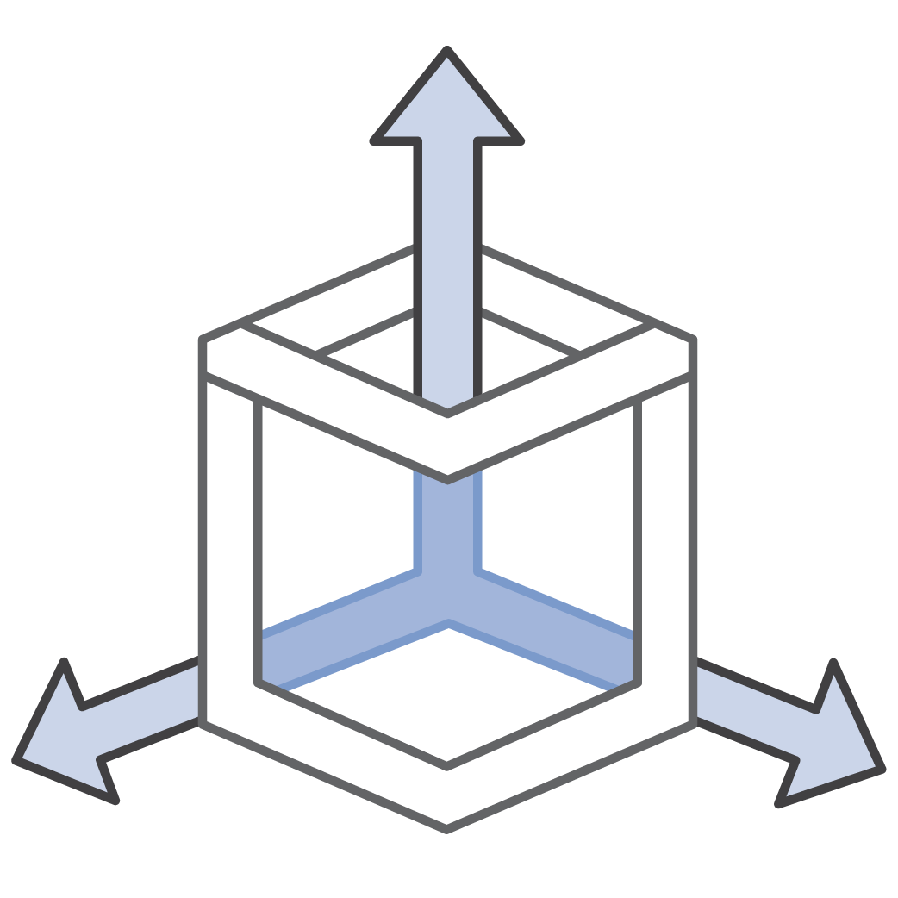
Why EMR? Elastic
Scale Up
Scale Down
Auto Scale

Slide 20
EMR Nodes
EMR cluster
Master Node must keep running
Master instance group
Core nodes can be added and removed gracefully
Cluster can tolerate loss of task nodes.
HDFS
HDFS
Core instance group
Task instance group
Notes:
Core nodes can be added and removed using Resize.

Slide 21
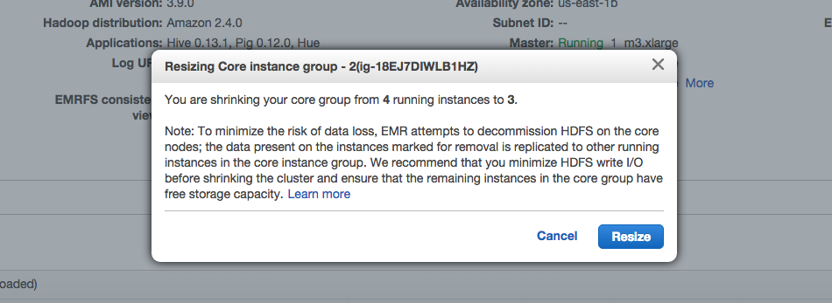
Intelligent Scale Down: Core nodes

Slide 22
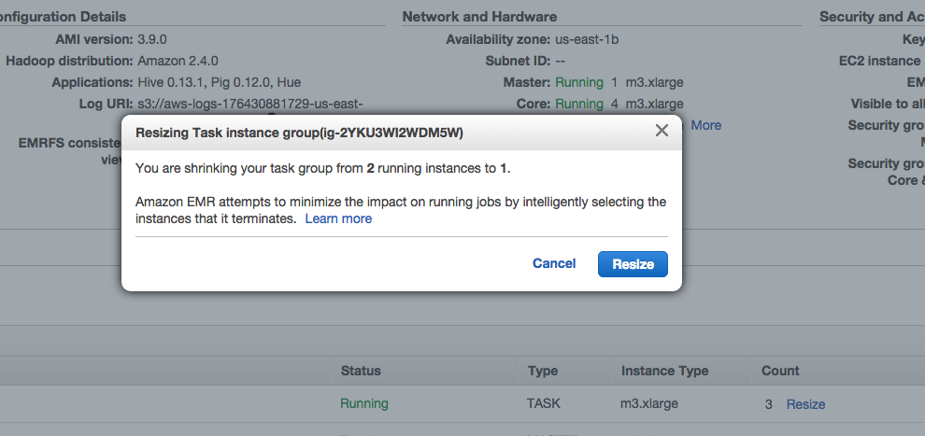
Intelligent Scale Down: Task nodes

Slide 23
Why EMR?
Automation
Decouple
Elastic
Integration
Current
Low-cost

Slide 24
Why EMR? Integration with AWS services
Kinesis Connector for streaming data access
Spark Streaming with Kinesis Client Library (KCL)
S3 via EMRFS
EBS support for scaling HDFS
Amazon KMS for encryption key management
Map Amazon DynamoDB tables with DynamoDB- connector for Hive
Connect to Amazon Redshift through redshift-spark connector
Wrap Amazon EMR cluster with IAM roles for access policies
Notes:
Connectors available for Kinesis-SparkStreaming, via KCL | DynamoDB | Redshift-spark | S3 via EMRFS |
Easy KMS and Datapipeline integration thanks to IAM roles

Slide 25
Why EMR?
Automation
Decouple
Elastic
Integration
Current
Low-cost

Slide 26
Why EMR? Current
Application | Open source release | EMR release
Spark 2.3.0 | February 28, 2018 | April 10, 2018
Spark 2.2.1 | December 1, 2017 | January 22, 2018
Spark 2.1.0 | December 28, 2016 | January 26, 2017
Spark 2.0.2 | November 14, 2016 | November 21, 2016
Spark 2.0 | July 26, 2016 | August 2, 2016
Spark 1.6.1 | March 9, 2016 | April 4, 2016
Spark 1.6 | January 4, 2016 | January 2016
Notes:
EMR users Apache Big top to keep the software releases up to date with the open source versions. Looking at spark versions time to EMR has been mostly <3 weeks.
Spark
Spark 1.5
September 9, 2015
Spark 1.5.2
November 9, 2015
Spark 1.6
January 4, 2016
Spark 1.6.1
March 9, 2016

Slide 27
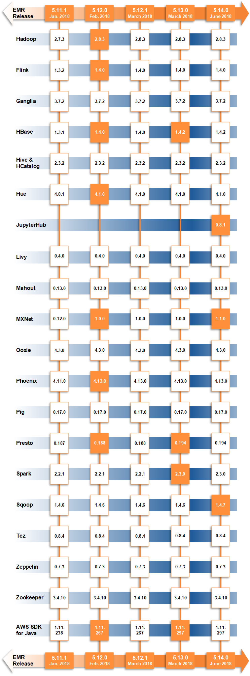

Slide 28
Why EMR?
Automation
Decouple
Elastic
Integration
Current
Low-cost

Slide 29
Why EMR? Low-cost
Transient clusters

Slide 30


Cost & time
# CPUs
# CPUs
Time
Time
Wall clock time: 10 hours
Wall clock time: 1 hour

Slide 31
Why EMR? Low-cost
Transient clusters
Reserved instances
Spot instances
&
Instance Fleets

Slide 32
Spot Market
C3
1a
1b
1c
On
Demand
8XL
$0.50
$0.27
$0.29
$1.76
Each instance family
4XL
$0.21
$0.30
$0.16
$0.88
Each instance size
2XL
$0.08
$0.07
$0.08
$0.44
Each Availability Zone
XL
$0.04
$0.05
$0.04
$.22
In every region
L
$0.01
$0.01
$0.04
$0.11
Is a separate Spot Market

Slide 33
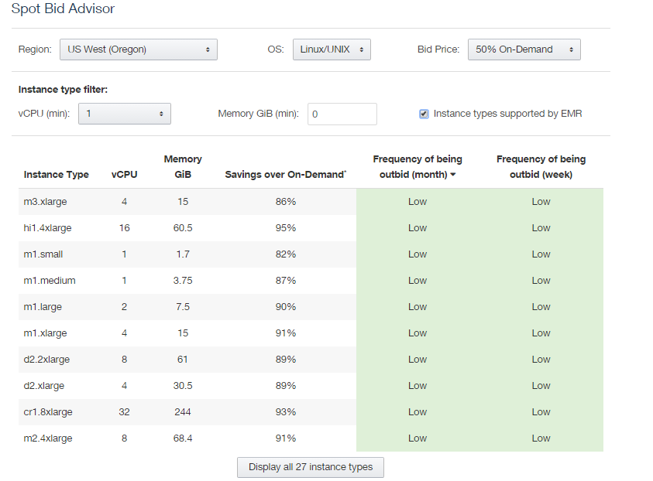
The Spot Bid Advisor

Slide 34
Multiple Task Groups
EMR cluster
Master instance group
Potentially different EC2 instance types and spot prices
.07c
.06c
.05c
.05c
HDFS
HDFS
.07c
.06c
.05c
.05c
Core instance group
Task instance groups

Slide 35




Instance fleets for advanced Spot provisioning
Master Node
Core Instance Fleet
Task Instance Fleet
Provision from a list of instance types with Spot and On-Demand
Launch in the most optimal Availability Zone based on capacity/price
Spot Block support

